Slide 1
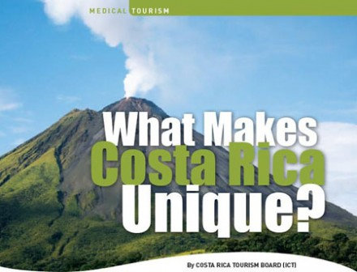





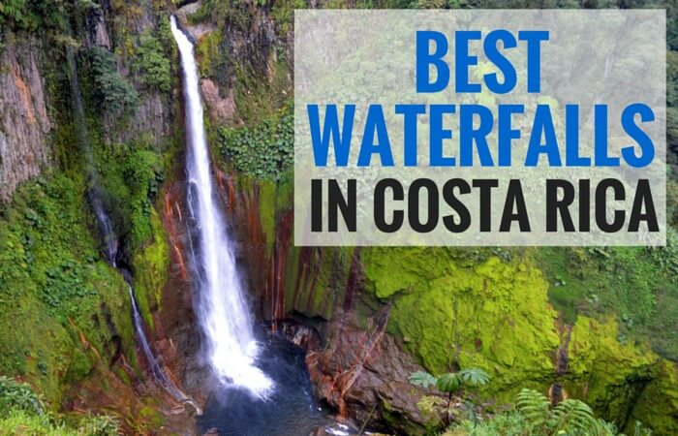
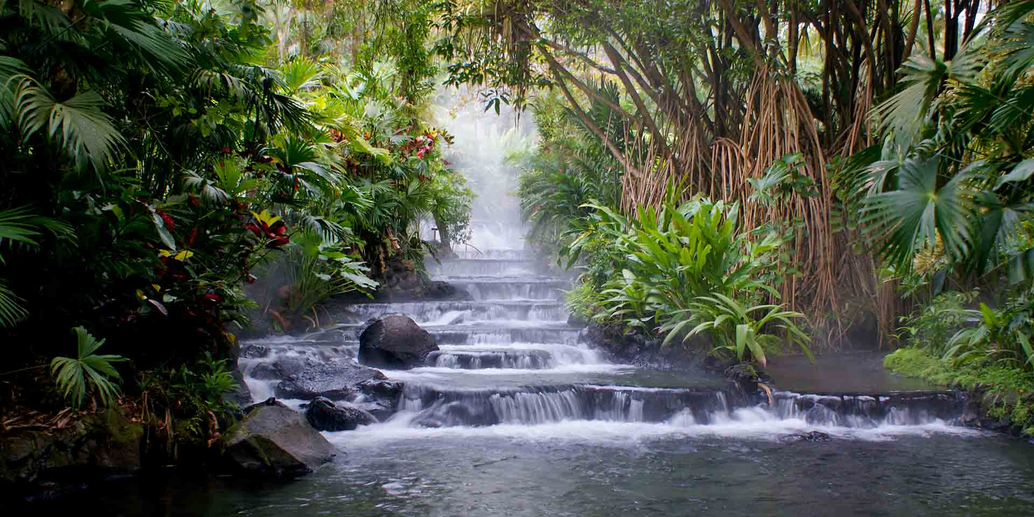
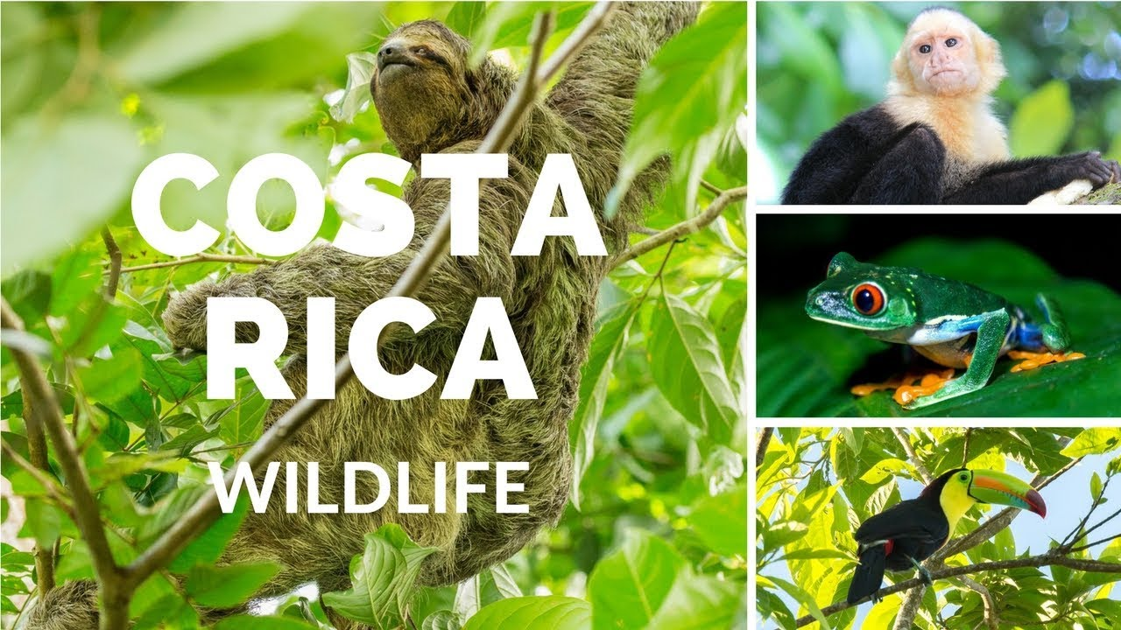
Siete maneras de colaborar
en PowerPoint
Costa Rica has…
1. The most mysterious volcanoes
2. The most beautiful beaches
3. The best waterfalls you can find
4. The best hot springs in the world
5. The most exotic animals

